Slide 1
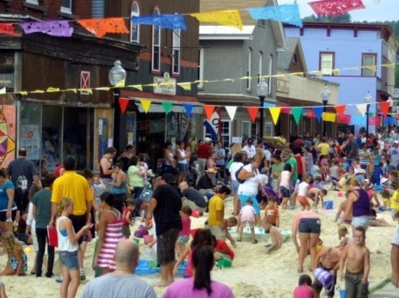
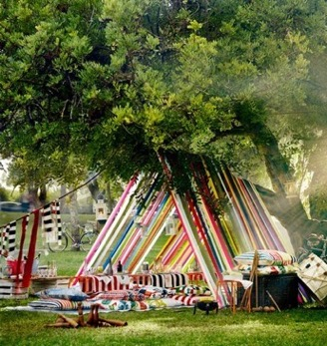
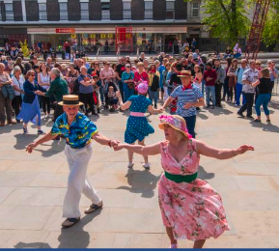
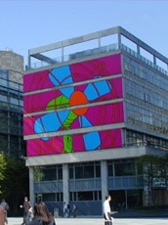
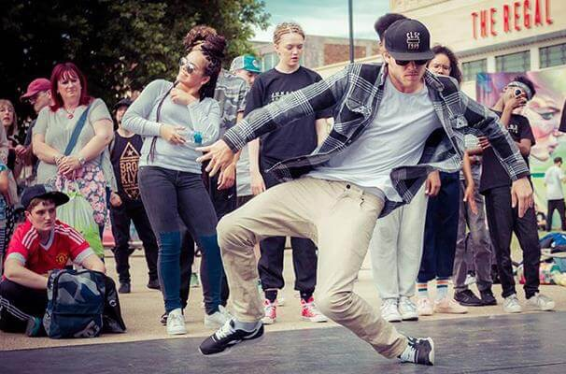
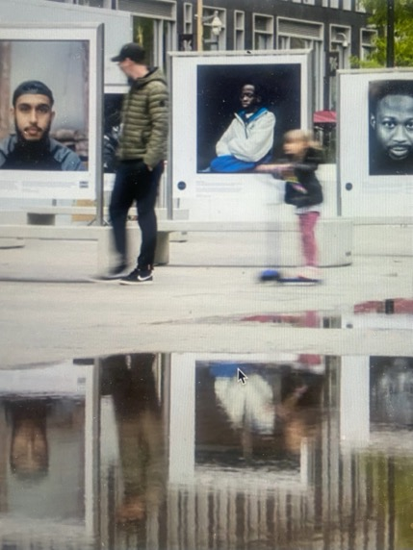
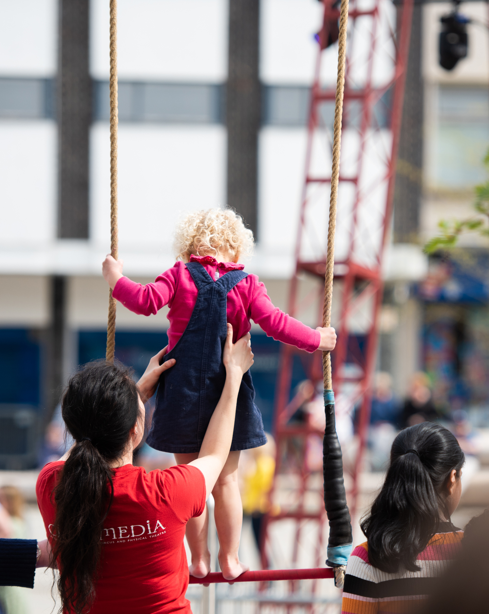
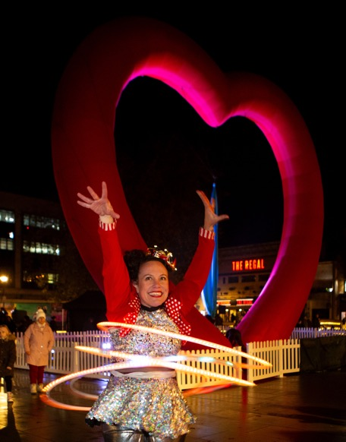
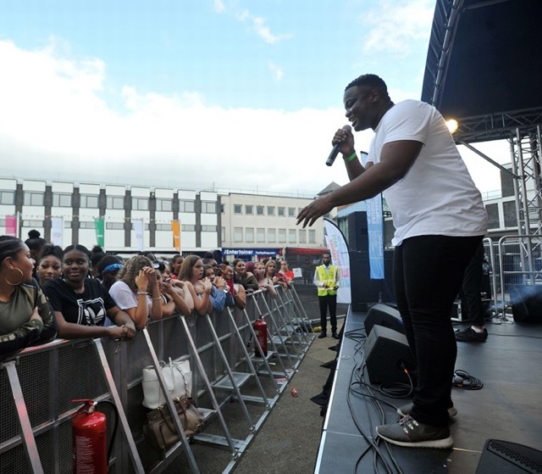
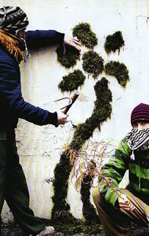
Kings Square Commission brief
Open: 1 July
Deadline for Expressions of Interest: 31 July
All Applicants contacted by 20 August

Slide 2
Is your project/event/idea…
Gloucester-based – taking place in Gloucester
Collaborative – working with partners and involving community
Memorable - to have an impact and create memories
Engaging - developing new audiences, engaging young and older people
Lasting – will leave a legacy for Gloucester
?
Then we want to hear from you!
Your Project

Slide 3
Community Square
What can you apply for?
Twilight Square
Exhibition Square
Performance Square
Session Square
Community-led activities.
Weekly active sessions
Durational piece or site-specific art piece
Showcase of local emerging talent
Music sessions
Up to £500
Up to £1500
Up to £10,000
Up to £6,000
Up to £4,500
1 day activity
Weekly repeating activity
Minimum 7 days to semi-permanent
1 day activity
6-10 gigs
Bring an activity or area to an existing event..
Gloucester Goes Retro
Gloucester Lanterns and Lights Switch On

Slide 4
Community Square
Exhibition Square
Bring the community together in a 1-day event of active and/or creative activities. You could offer drop-in activities, timetabled slots, mass participation, or a series of mini activities to run alongside each other.
Your idea could be:
Themed
Representing or celebrating particular communities
One big event which this commission would contribute towards
A smaller activity which could form part of a community event
You will receive:
- Up to £500
- The use of Kings Square
- Advice and support from the Together Gloucester team for planning and production
- Use of a PA system
- Networking opportunities and links with partners throughout Gloucester

Slide 5
Twilight Square
2 periods (July-Aug, Sept-Oct) a regular 5-6pm/6-7pm movement-based club/class on a consistent week-day evening. Two different activities, alternating weekly over these months.
Or 4 months, one club running for 4 weeks – which months will depend on how soon we can get a call out – in future years we could do May/June etc
Salsa, ceilidh, breakdance, Zumba etc. £1500 to run 4 sessions x 4.
Some consultation useful with potential service providers
Get people up and moving in weekly dance and movement sessions.
You will deliver a series of sessions (minimum of 4).
Some consultation useful with potential service providers.
You will receive:
- Up to £1500
- The use of Kings Square
- Advice and support from the Together Gloucester team
- Use of a PA system
- Networking opportunities and links with partners throughout Gloucester

Slide 6
Exhibition Square
Exhibition Square
Are you an artist with a big idea? We are looking for a durational or site specific piece, installation or exhibition to inspire our residents and visitors.
Your piece must be on show for a minimum of 7 days or offer a semi-permanent creation for the city.
You will receive:
- Up to £10,000
- The use of Kings Square
- Advice and support from the Together Gloucester team
- Networking opportunities and links with partners throughout Gloucester

Slide 7
Performance Square
Exhibition Square
Showcase local emerging artists in a one-day event.
You will receive:
- Up to £6000
- The use of Kings Square
- Advice and support from the Together Gloucester team
- Use of a PA system
- Networking opportunities and links with partners throughout Gloucester

Slide 8
Session Square
Exhibition Square
Bring Kings Square to life with a series of music gigs. We are looking for quality gig sessions showcasing Gloucester’s home-grown talent.
You will deliver a minimum of 5 sessions.
You will receive:
- Up to £4500
- The use of Kings Square
- Advice and support from the Together Gloucester team
- Use of a PA system
- Networking opportunities and links with partners throughout Gloucester

Slide 9
Gloucester Goes Retro
If you would like to bring your project or idea to an existing event, Gloucester Goes Retro could be for you.
Exhibition Square
Date: Saturday 24 August 2024
We are looking for
Stall holders
Sustainable fashion
Vintage Games
Buskers
Swap shops
Vintage photo booth
Dance workshops
Music through the ages
Antiques
Vintage and retro food
If you want to get involved, or for more information on Gloucester Goes Retro, please contact the team at City.Events@gloucester.gov.uk, phone +441452 396779 or come to a drop in session and chat to the Together Gloucester Team, taking place Tuesdays in July.

Slide 10
Lanterns and Light Switch On
Exhibition Square
Launching the festive season in Gloucester, the lantern parade and light switch on welcomes 8000 visitors into the city.
If you would like to join the winter celebrations and have an idea for creating a memorable experience for audiences, get in touch with the team at City.Events@gloucester.gov.uk, phone +441452 296779, or come to a drop in session and chat to the Together Gloucester Team, taking place Tuesdays in July.

Slide 11
How to apply
Your application
Read the commission brief and guidance in this document.
Want to discuss ideas?
Book a slot on Tuesdays in July with the Together Gloucester Team. Email: Vashti@gloucesterculture.org.uk
Email your Expression of Interest to City.Events@gloucester.gov.uk by 31 July 2024
Expressions of interest will be reviewed by the Together Gloucester civic panel and strategic partners
Second stage
Successful applicants will be invited to discuss their idea with the Together Gloucester team on 14 or 15 August 2024
Second Stage Decisions will be communicated to applicants by
20 August 2024
Successful applicants will be invited to meet with the Together Gloucester producer to discuss your project in detail.
Deliver your proposal and submit evaluation within 6 weeks of delivery for final payment

Slide 12
Eligibility Criteria
Guidance for applicants
To be eligible, the project must:
Be free to attend/take part
You/your organisation must:
Be either a legally constituted organisation (not for profit) or if applying as an individual include a letter of support in reference from an organisation about you and to demonstrate that you are ‘not-for-profit’
Take place between 16 August 2024 and 14 March 2025.
Embrace the importance of partnership work
Be in Kings Square
Have a bank or building society account
Not have received Arts Council England National Portfolio Organisation funding for the activity you are applying for

Slide 13
Guidance for applicants
The Kings Square Commissions Pot seeks to support projects that:
Have a strong connection to Gloucester
Provide exciting creative arts activities which engage local communities and have a public benefit to residents of Gloucester
Benefit residents of Gloucester through cultural activity or development that addresses an identified gap in current provision
Contribute to one of Together Gloucester four step changes
Demonstrate clear planning, delivery and evaluation methods
Evidence project and budget management skills (e.g. the budget balances)
Demonstrate a commitment to accessibility, inclusion and environmental sustainability

Slide 14
Together Gloucester 4 Step Changes
Guidance for applicants
Empower Gloucester’s citizens to celebrate their identity
Put citizens at the centre of Gloucester’s cultural decision-making process
Improve the health and well-being of communities, supporting cross sector organisations to work together
Make Gloucester a better place to live, work and visit where people know they can engage in fun, cultural activity

Slide 15
Expression of Interest
Guidance for applicants
Let us know
Which commissioning pot are you applying for – Community/Twilight/Exhibition/Performance/Session or an idea for Gloucester Goes Retro or Lanterns and Light Switch on?
What would you like to bring to Kings Square?
Describe the community* this project will reach?
How do you know the community wants this to happen?
How will you make your event engaging and accessible?
Tell us about who else will be involved? This might include artists, partners, other creative organisations…
When will it happen? Please include proposed dates for your activity in Kings square
Your budget: what will you spend the money on (in detail)
* Communities can be defined by: A shared interest or experience; A geographic area; Innate personal characteristics (i.e. age, gender, race, ethnicity); Values and beliefs (i.e. religion)

Slide 16
Expression of Interest
Guidance for applicants
Your expression of interest can be sent to us in whatever format that makes most sense to you / your project. This can be in written description, presentation with photographs, audio/voice note or video. You can also send us a couple of examples or links to help illustrate your project.
Send your expression of interest (including budget information) by 31st July to:
City.Events@gloucester.gov.uk
Phone: +441452 396779

Slide 17
Budget Tips
We want to be able to assess whether your project is fully thought through and deliverable. We have provided an example budget template for you to use as part of your application. You don’t need to use this if you prefer to present your budget in your own way.
We look for budgets that are fair, make sense, and will deliver what you need to do.
Remember that your budget also tells your story – if something is important in your project, make sure it’s also clear in the budget.
Make sure your budget is based on reality – get some quotes and check how much things cost as you’re pulling your plans together, this can also help you get agreements on things people will provide for free or ‘in kind’ (like rehearsal space, specialist advice etc.)
Include ‘in kind’ agreements in your budget in both the income and expenditure sections – this helps funders see the true value of your project and can help you reach any match funding you might need.
You don’t need to have match funding and you will not be more likely to succeed if you do have match funding in place.
If your plans mean that you do need additional funding, make sure you tell us how you plan to get it, and what you will do if you don’t get it.
You must include ‘fair pay’ for everyone involved. You can get guidance on fair rates of pay from organisations like Equity, ITC or Artists’ Union England – or drop us an email if you need advice.
Don’t forget accessibility – what do you need to put in place to ensure your project is a great experience for everyone – creatives, employees, participants, and audiences?
You do not need to be a registered company or charity, but if you are a freelancer, you will need to be registered as self-employed and pay your own tax and national insurance. You can arrange for your budget to be held and managed by a trusted partner or producer if you would prefer this for access or other support reasons.
It’s OK if once your project starts, your plan or the way you use the funding, changes, as long as you’re still working on the same idea and you keep in touch and let us know what's happening.

Slide 18
Partners

